Slide 1

Symmetric / Asymmetric Encryption
Symmetric Encryption
Asymmetric Encryption
vs.

Slide 2
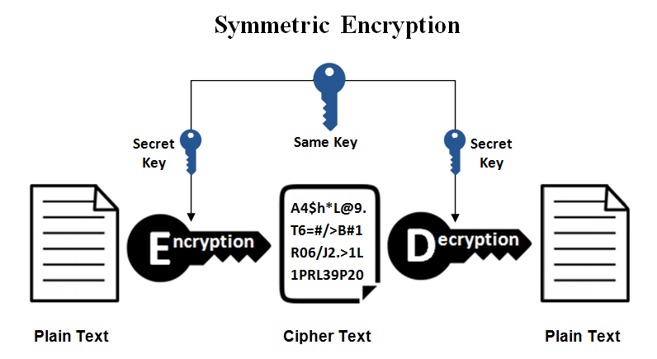
Symmetric Encryption
A single secret key to cipher / decipher
The secret key can be a number or string
Both the sender and the recipient should know the secret key
Widely used symmetric algorithms: AES-128, AES-256, Twofish, IDEA

Slide 3
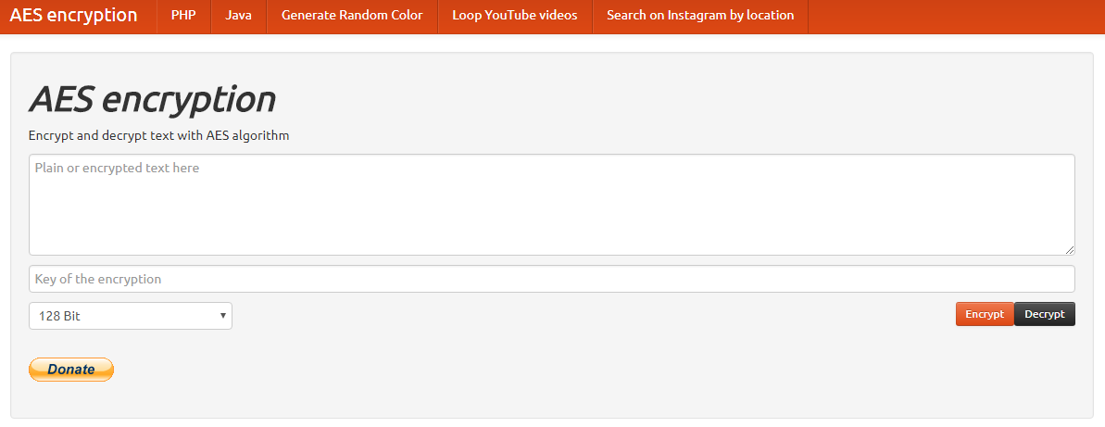
Live Demo
AES Encrypt / Decrypt: https://aesencryption.net

Slide 4
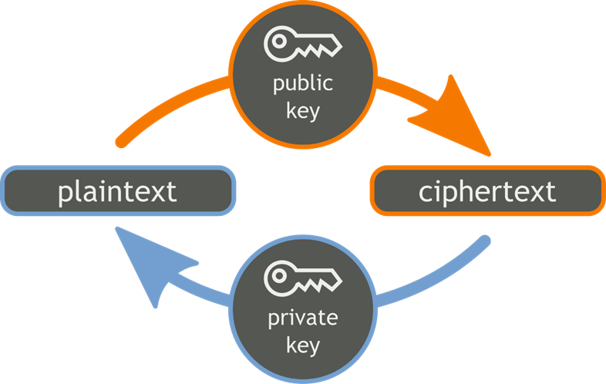
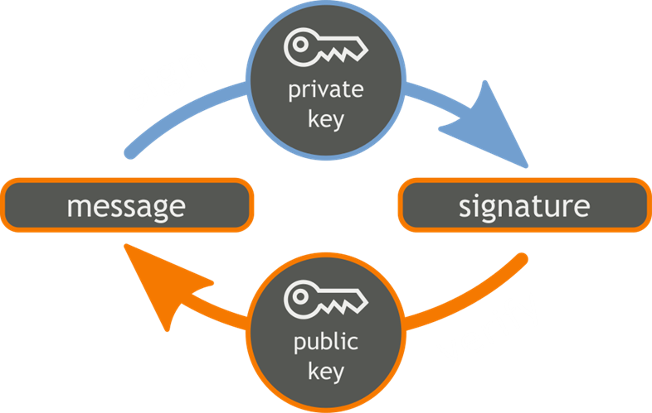
Public Key Cryptography
Uses a pair of keys: public key + private key
  Encrypt / sign by private key
  Decrypt / verify by public key

Slide 5
Public Key Crypto Systems
Well-known public-key crypto-systems
  RSA – based on discrete logarithms
  ECDSA – based on elliptic curves (ECC)
  3072-bit RSA key ≈≈ 256-bit ECC key
ECC cryptography is considered more secure
  Most blockchains (like Bitcoin and Ethereum) use ECC
  Still, it is not quantum-safe!

Slide 6
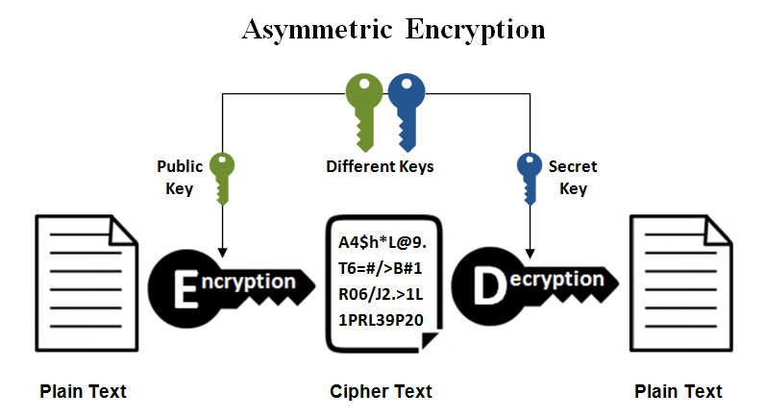
Asymmetric Encryption
Public-key cryptography:
  Use public / private keys to encrypt / decrypt data
The public key can be shared with everyone
The private key is kept secret
Encrypt a message using the public key
Decrypt the message only with the private key
Popular asymmetric algorithms: RSA, EIGamal, DSA, Elliptic Curve DSA

Slide 7
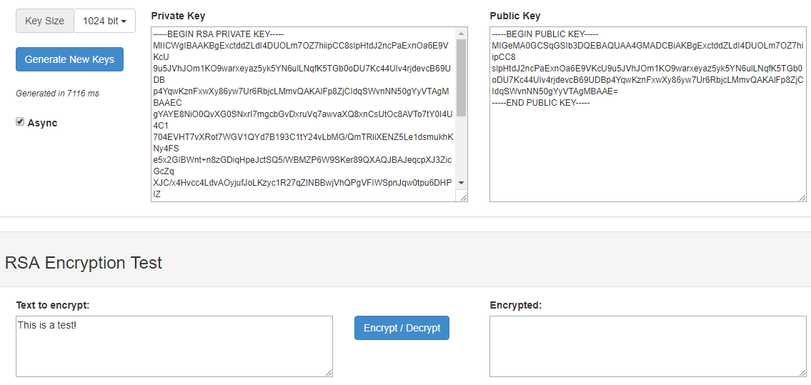
Live Demo
JSEncrypt (Generate RSA Keys and Encrypt): http://travistidwell.com/jsencrypt/demo/

Slide 8

Symmetric / Asymmetric Encryption
Try the Demo!

